Slide 1

Machine Learning with Scikit-Learn and TensorFlow (자원탐사 융합해석을 위한 파이썬 라이브러리를 활용한 머신러닝)
KIGAM, Feb 19-23, 2018
Day 1
Daeung Yoon (윤대웅)
Hanyang University

Slide 2
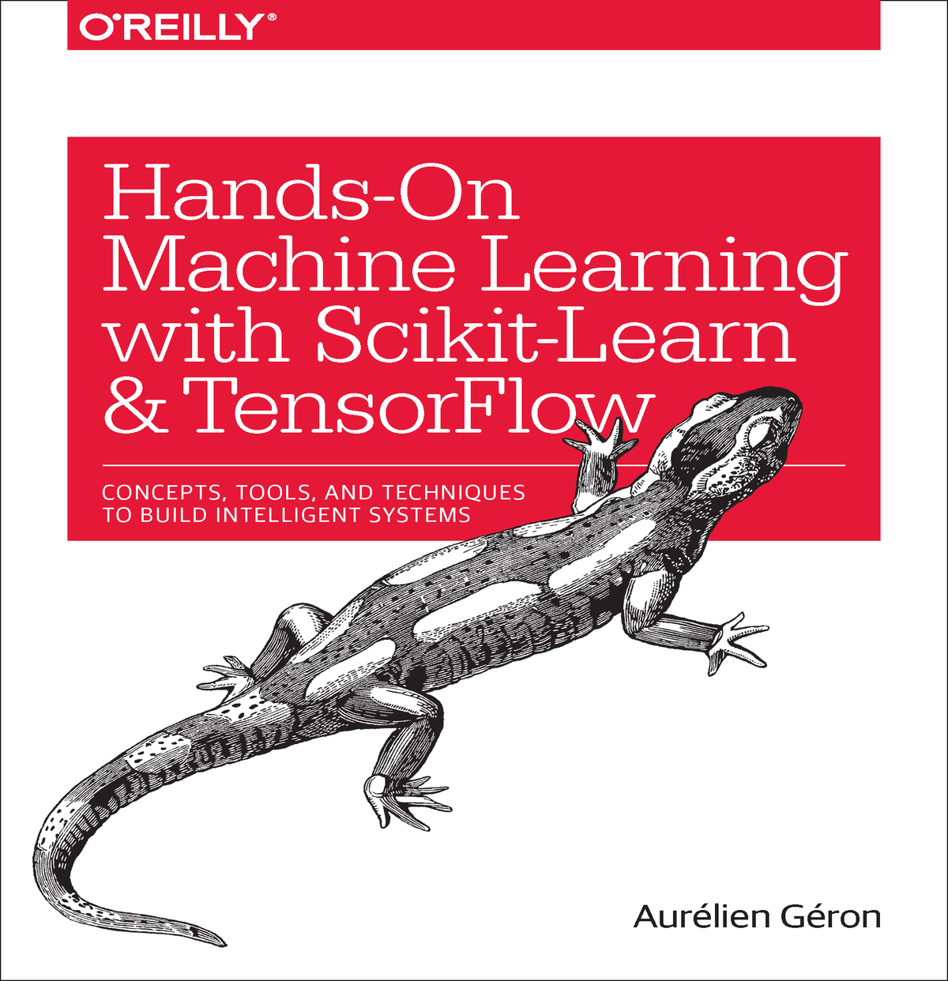
참고 자료
Hands-On Machine Learning with Scikit-Learn and TensorFlow by Aurelien Geron
cs231n (Convolutional Neural Networks for Visual Recognition)
강의 자료 및 예제코드 다운로드 주소
https://github.com/duyoon/kigam_ml_seminar_2018

Slide 3
교육 시간표
 | 2.19 (월) | 2.20 (화) | 2.21 (수) | 2.22 (목) | 2.23 (금)
오전 | Python for machine learning | Linear/Logistic Regression | Decision Trees | TensorFlow Basics | Convolutional Neural Networks
오후 | Intro to machine learning | Support Vector Machines | Random Forests | Artificial Neural Networks | Convolutional Neural Networks
 | Data Preprocessing | Model Evaluation | Gradient Boosting | Deep Neural Networks | Recurrent Neural Networks

Slide 4
00. Python for Machine Learning

Slide 5
1. Introduction to Machine Learning

Slide 6

AI, Machine Learning and Deep Learning
Artificial intelligence
Simulation of human intelligence processes by machines, especially computer systems.
These processes include learning (the acquisition of information and rules for using the information), reasoning (using the rules to reach approximate or definite conclusions), and self-correction.
Machine Learning
Field of study that gives computers the ability to learn without being explicitly programmed (Arthur Samuel, 1959)
Deep Learning
A set of algorithms in machine learning that attempt to model high-level abstractions in data by using architectures composed of multiple non-linear transformation

Slide 7
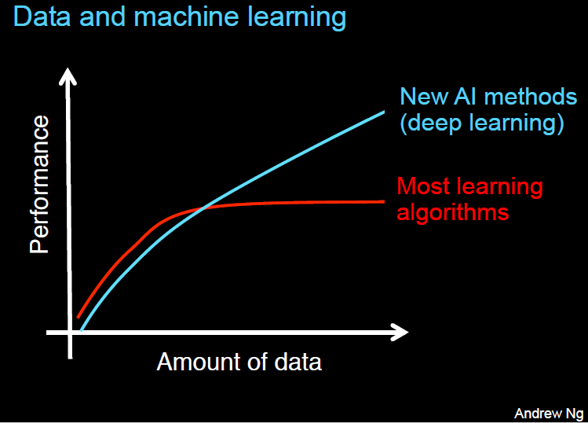
AI, Machine Learning and Deep Learning
Artificial intelligence
Simulation of human intelligence processes by machines, especially computer systems.
These processes include learning (the acquisition of information and rules for using the information), reasoning (using the rules to reach approximate or definite conclusions), and self-correction.
Machine Learning
Field of study that gives computers the ability to learn without being explicitly programmed (Arthur Samuel, 1959)
Deep Learning
A set of algorithms in machine learning that attempt to model high-level abstractions in data by using architectures composed of multiple non-linear transformation

Slide 8
What is Machine Learning?
General definition:
Machine Learning is the field of study that gives computers the ability to learn without being explicitly programmed.
- Arthur Samuel, 1959
Engineering-oriented definition:
A computer program is said to learn from experience E with respect to some task T and some performance measure P, if its performance on T, as measured by P, improves with experience E.
- Tom Mitchell, 1997

Slide 9
What is Machine Learning?
Engineering-oriented definition:
A computer program is said to learn from experience E with respect to some task T and some performance measure P, if its performance on T, as measured by P, improves with experience E.
Tom Mitchell, 1997
어떤 컴퓨터 프로그램이 어떤 작업(T)을 하는데 있어서 경험(E)에 따라서 측정된 성능(P)이 개선된다면 그 프로그램은 경험(E)에서 학습한다고 할 수 있다.

Slide 10
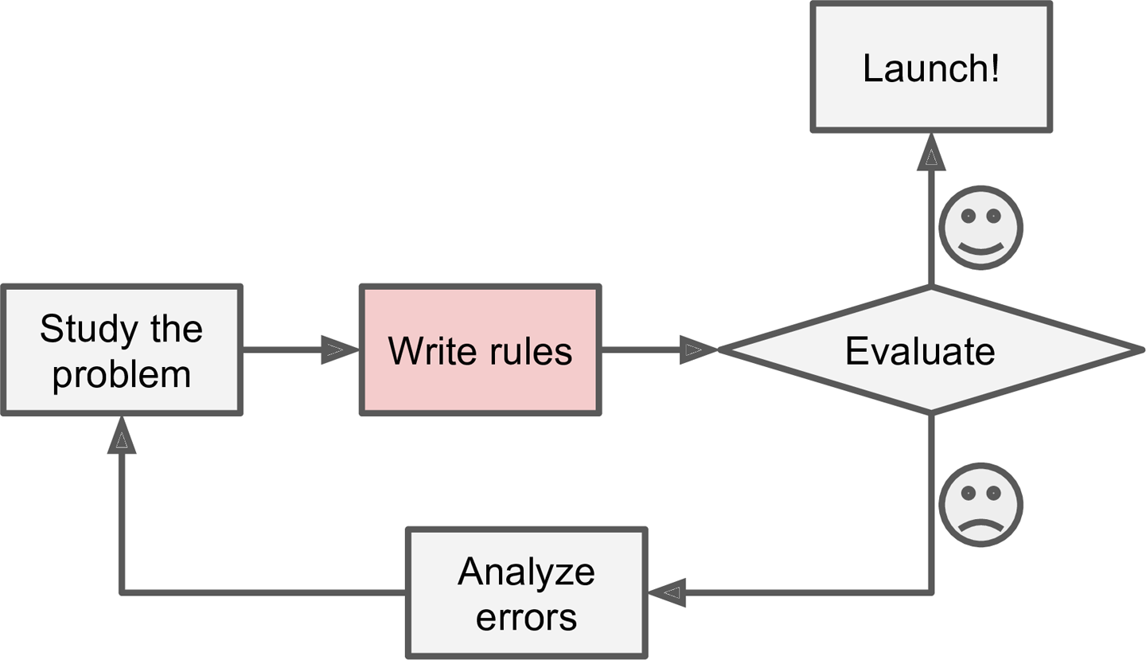
Why use Machine Learning?
< Spam filter example >
The traditional approach
spam_keywords = ['4U', 'free']
def spam_filter(email):
for word in email:
if word in spam_keywords:
return "SPAM!"
return "HAM!"
email1 = ['Hi','Daeung','Special','gift','4U']
print("email1 is " + spam_filter(email1))
email2 = ['Hi','Daeung','Special','gift','for U']
print("email2 is " + spam_filter(email2))
email1 is SPAM!
email2 is HAM!

Slide 11
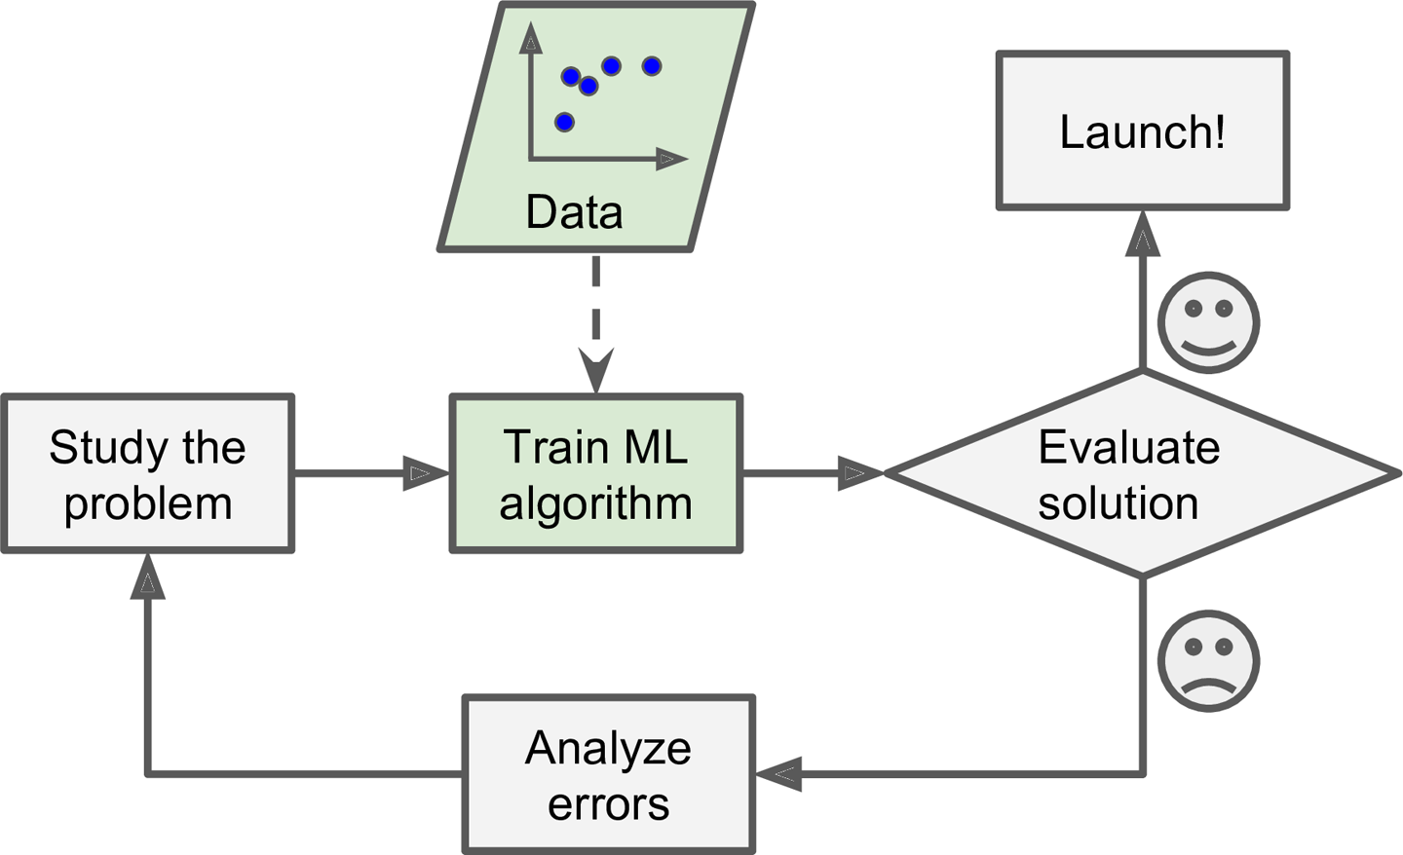
Why use Machine Learning?
< Spam filter example >
Machine Learning approach
model = MLAlgorithm()
model.fit(emails, email_labels)
email1 = ['Hi','Daeung','Special','gift','4U']
print("email1 is " + model.predict(email1))
email2 = ['Hi','Daeung','Special','gift','for U']
print("email2 is " + model.predict(email2))
email1 is SPAM!
email2 is SPAM!

Slide 12
Why use Machine Learning?
The traditional approach
Machine Learning approach

Slide 13
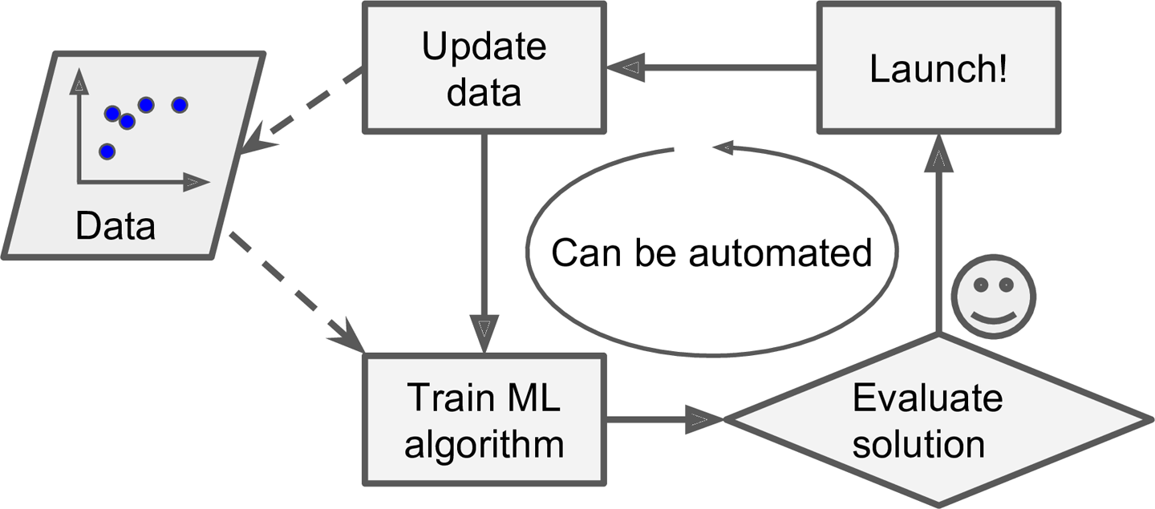
Why use Machine Learning?
The traditional approach
Machine Learning approach

Slide 14
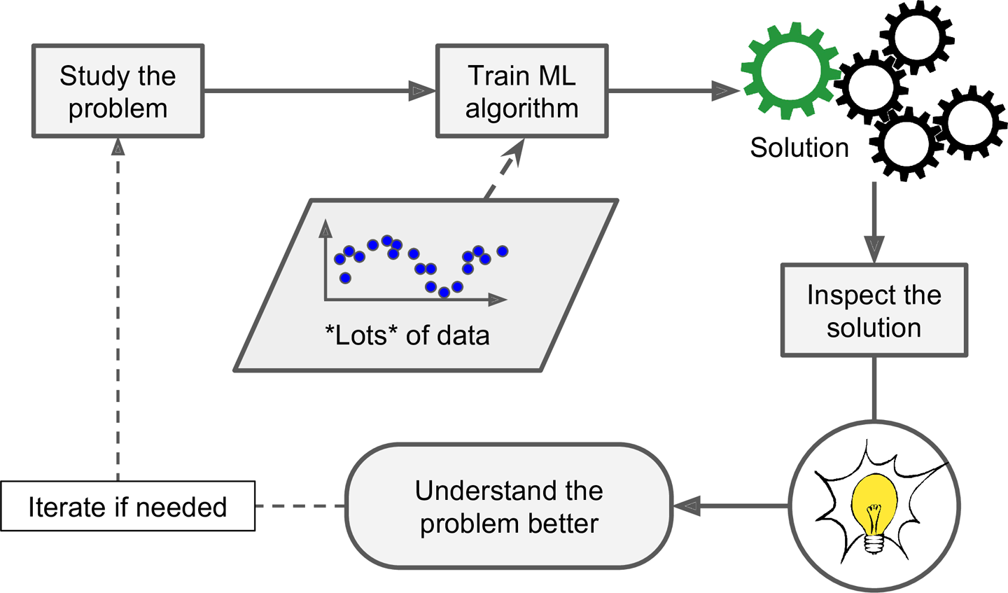
Why use Machine Learning?
Machine Learning can help humans learn

Slide 15
Why use Machine Learning?
Machine Learning can help humans learn

Slide 16
Types of Machine Learning Systems
Trained with human supervision or not
Supervised Learning
Unsupervised Learning
Semisupervised Learning
Reinforcement Learning
Able to learn incrementally on the fly or not
Online Learning
Batch Learning
Simply comparing new data points to known data points or detecting patterns and building a predictive model
Instance-based Learning
Model-based Learning

Slide 17
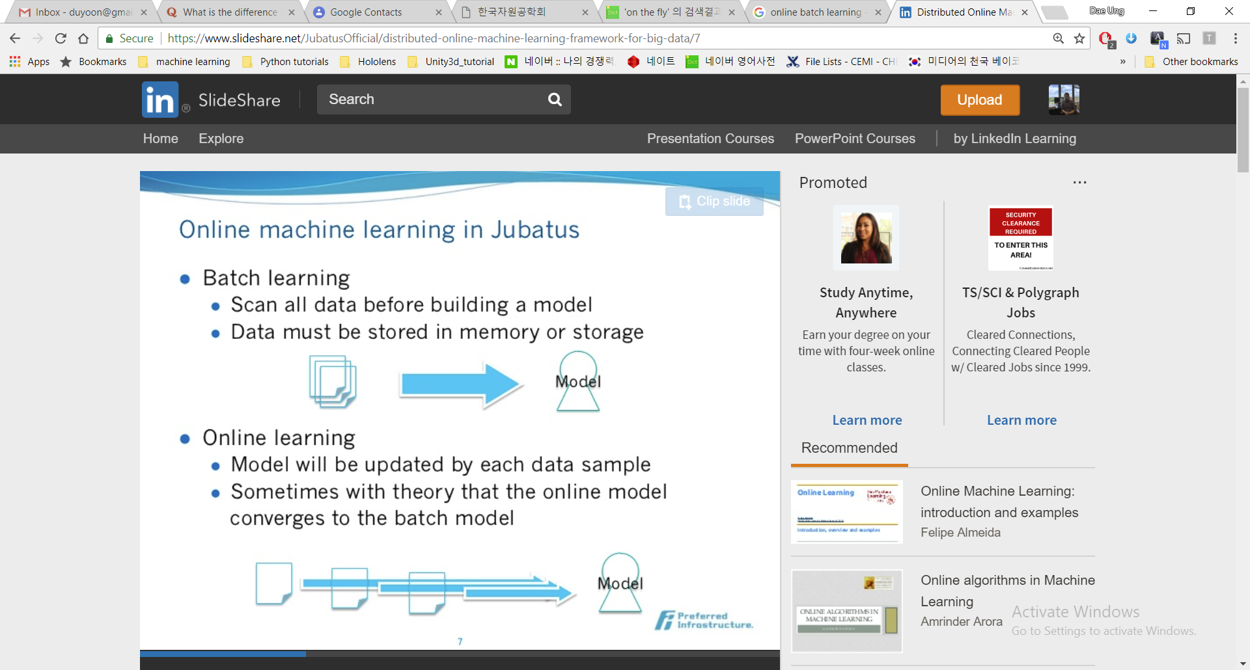
Batch and Online Learning
Batch learning (offline learning)
Scan all data before building a model
Data must be stored in memory or storage
Online learning
Model will be updated by feeding data instances sequentially, either individually or by small groups called mini-batches
Sometimes with theory that the online model converges to the batch model

Slide 18
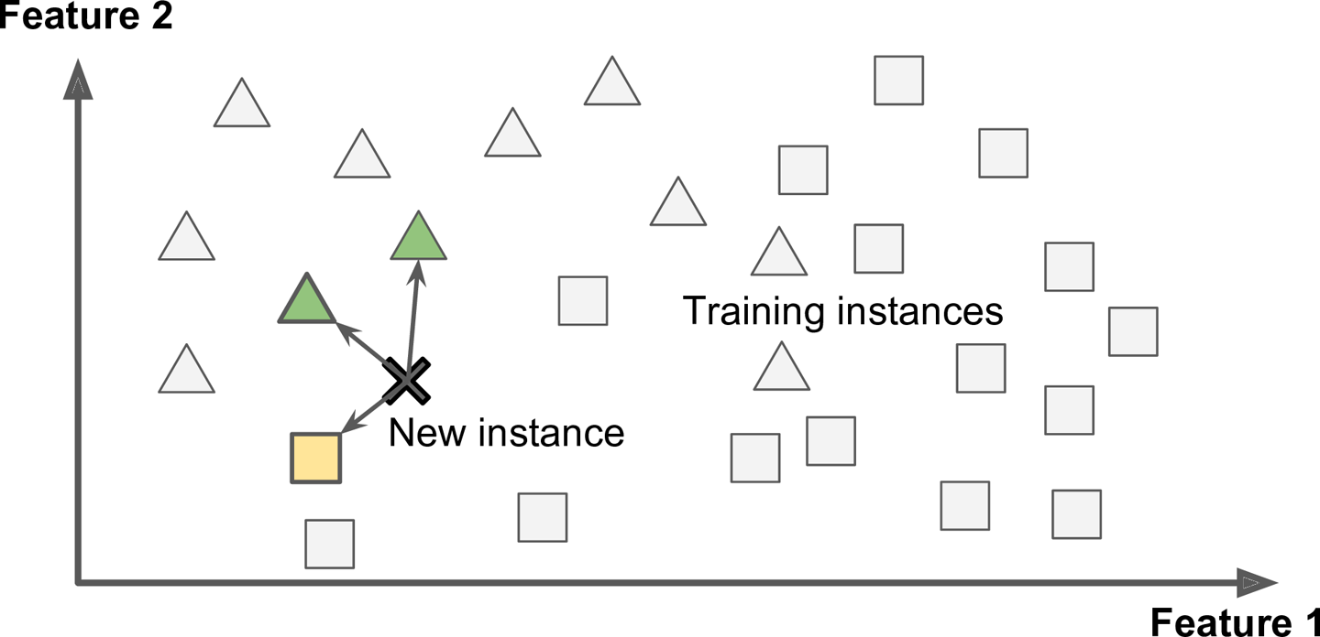
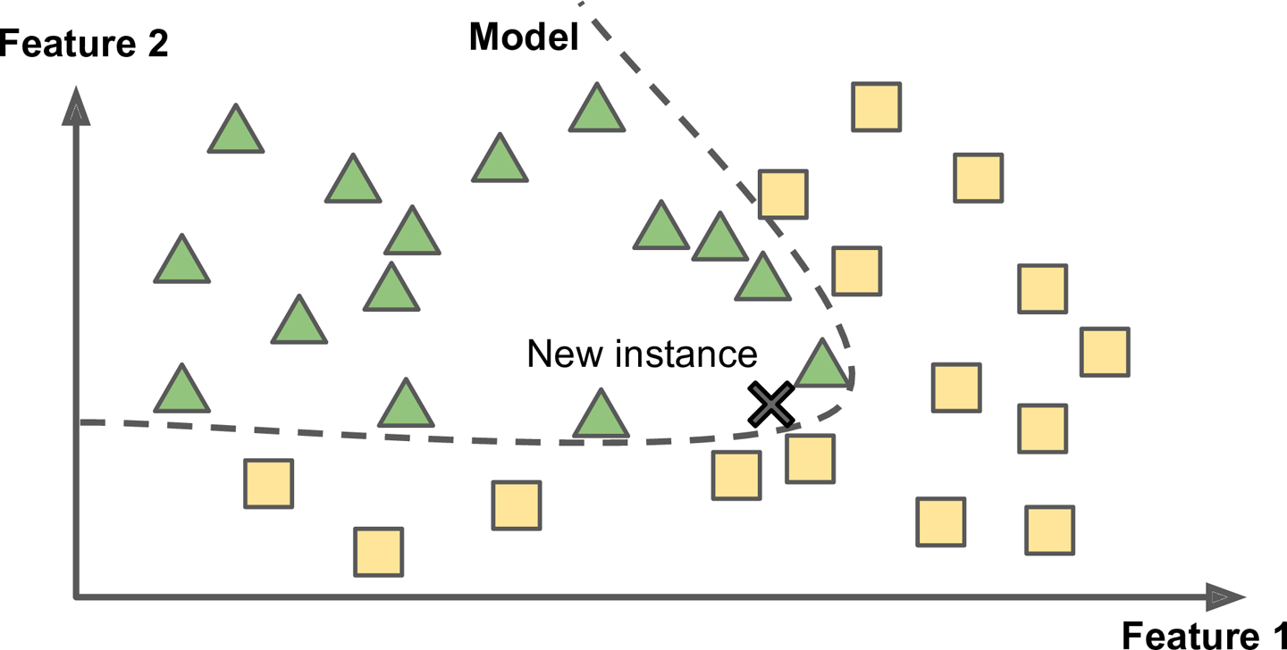
Instance-Based vs. Model-Based Learning
Instance-Based Learning
Model-Based Learning

Slide 19
Types of Machine Learning – Human supervision or not
Supervised Learning
Classification
Regression
Unsupervised Learning
Clustering
Dimensionality Reduction
Generative Models
…
Semi-supervised Learning
Reinforcement Learning

Slide 20
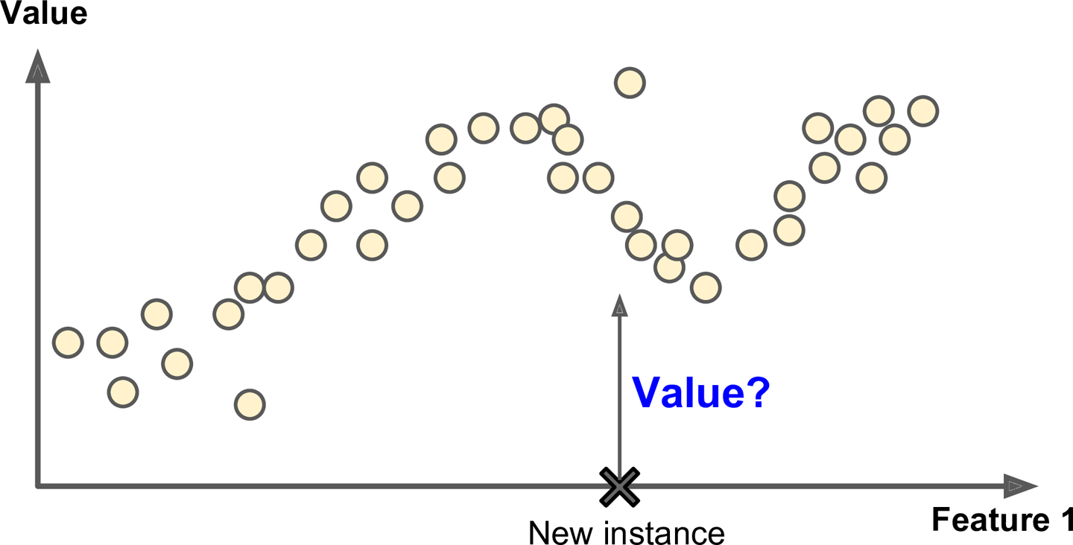
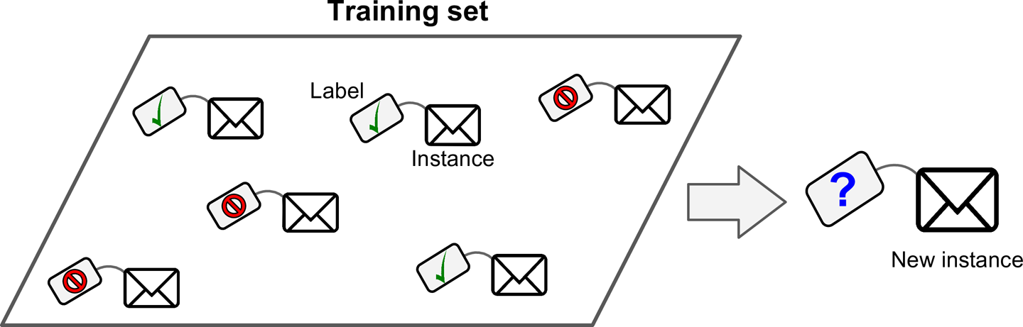
Types of Machine Learning – Human supervision or not
Supervised Learning
Classification
Regression
Unsupervised Learning
Clustering
Dimensionality Reduction
Generative Models
…
Semi-supervised Learning
Reinforcement Learning
<Supervised Learning>
Label(미리 정해놓은 정답)이 있는 자료로 학습
Classification
Regression

Slide 21
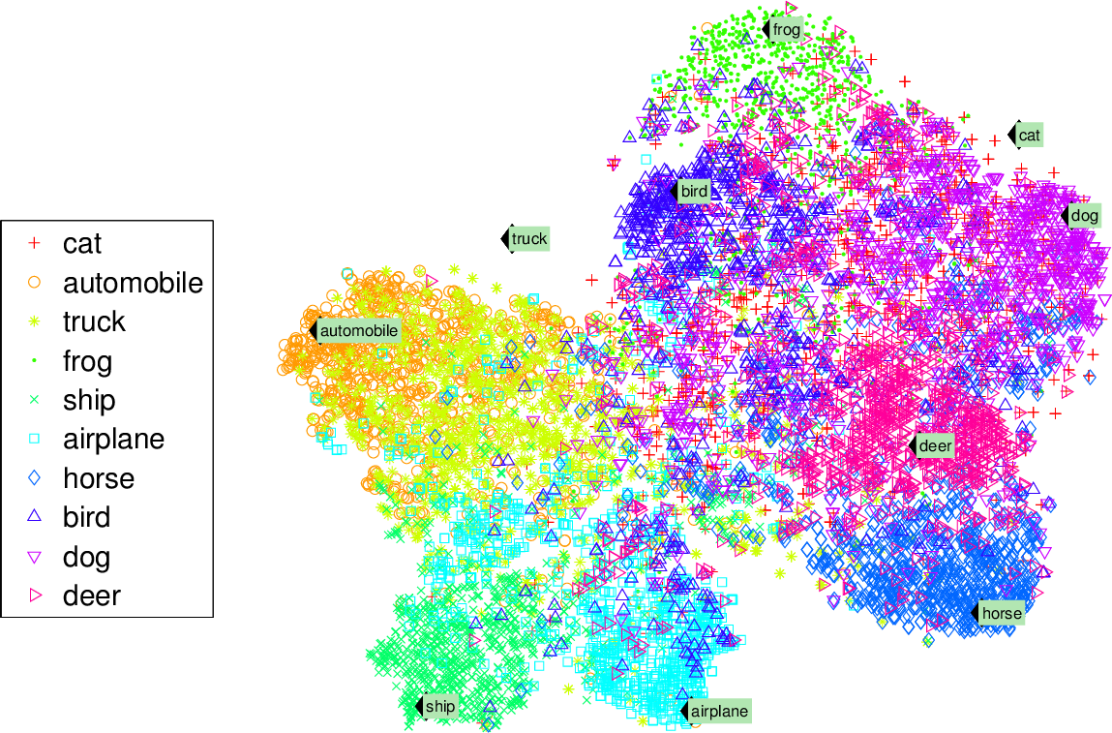
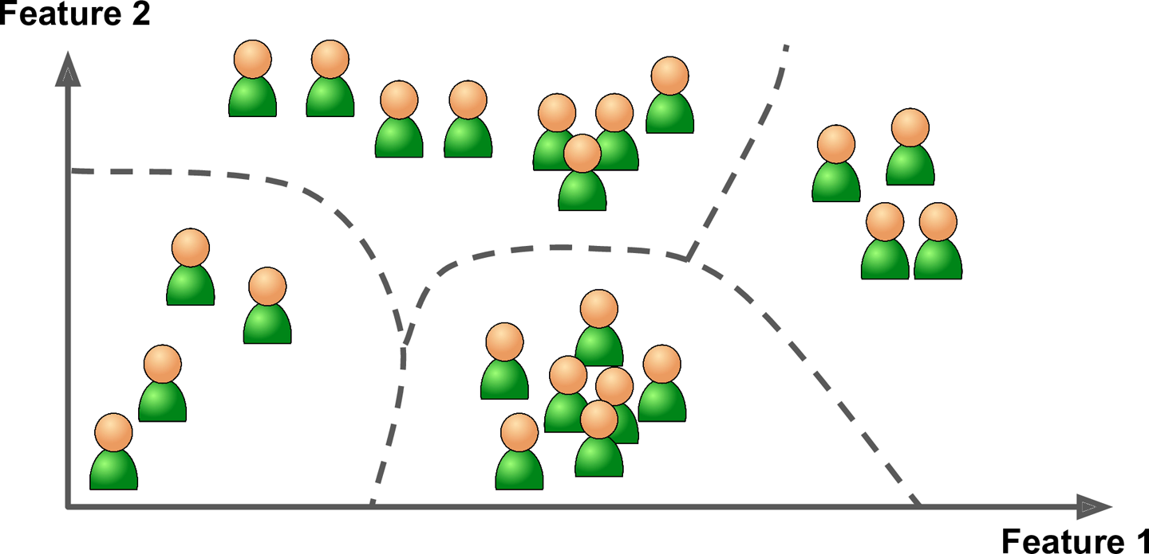
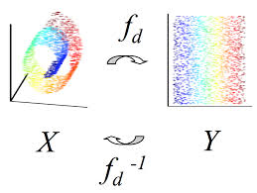
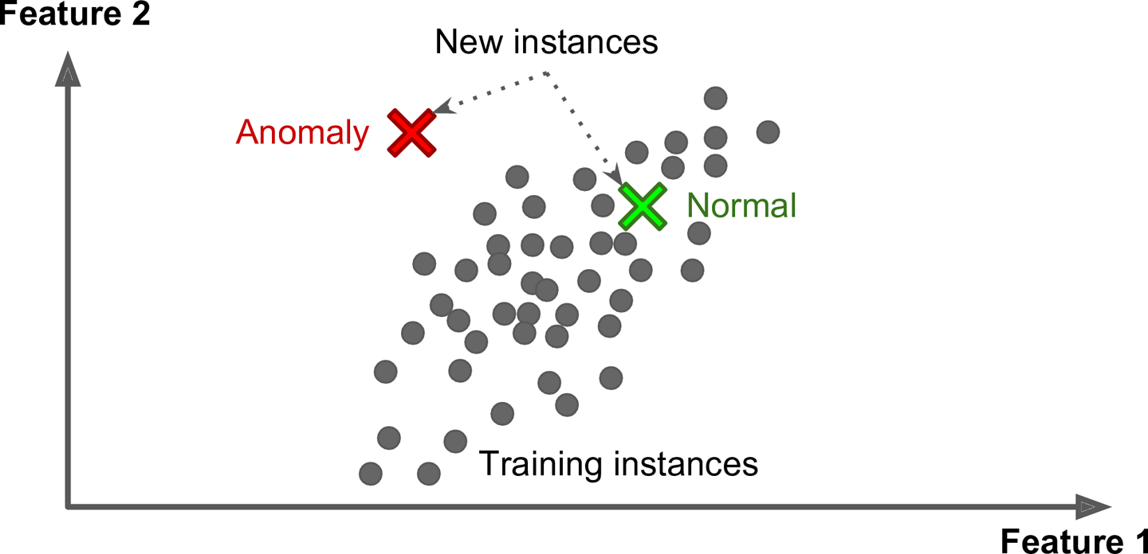
Types of Machine Learning – Human supervision or not
<Unsupervised Learning>
Supervised Learning
Classification
Regression
Unsupervised Learning
Clustering
Dimensionality Reduction
Generative Models
…
Semi-supervised Learning
Reinforcement Learning
Label(미리 정해놓은 정답)이 없는 경우
데이터에 내재된 패턴, 특성, 구조를 학습을 통해 발견
t-SNE visualization
Clustering
Dimensionality reduction
Anomaly detection

Slide 22
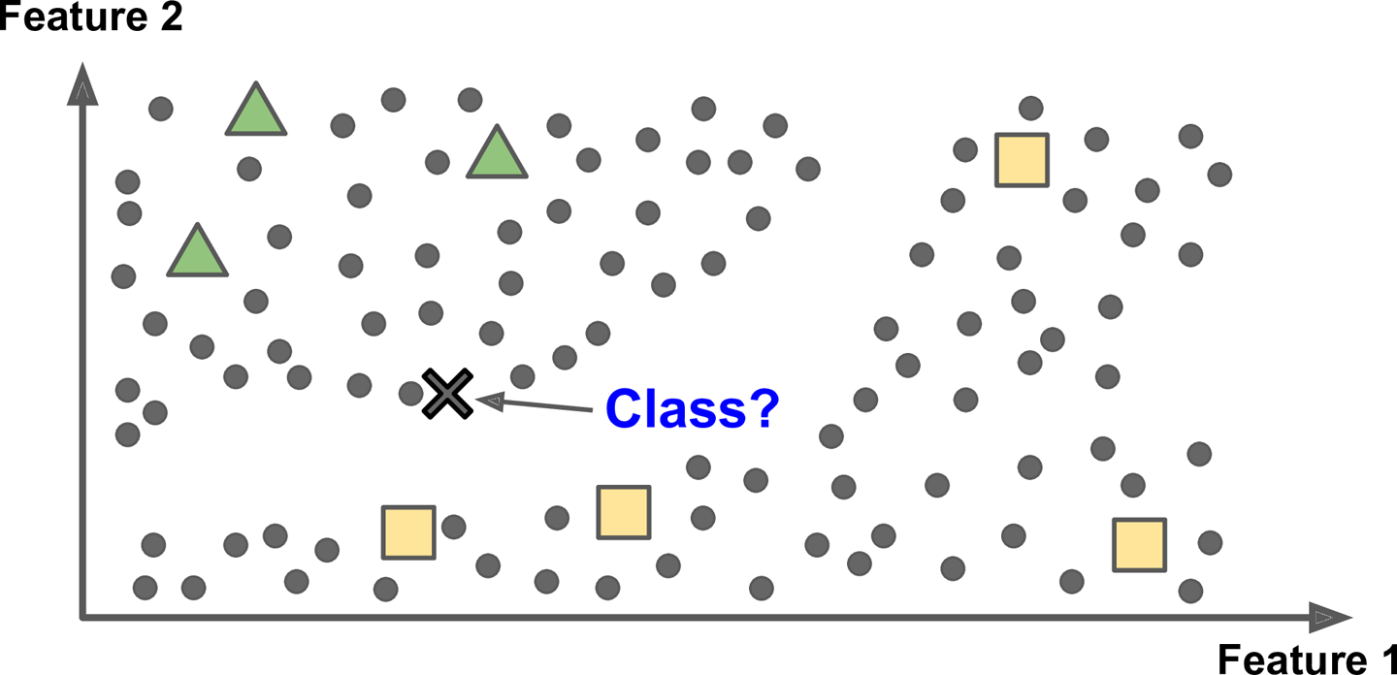
Types of Machine Learning – Human supervision or not
<Semisupervised Learning>
Supervised Learning
Classification
Regression
Unsupervised Learning
Clustering
Dimensionality Reduction
Generative Models
…
Semi-supervised Learning
Reinforcement Learning
Supervised + unsupervised
정답이 있는 데이터가 적고 정답이 없는 데이터가 많을 경우

Slide 23

Types of Machine Learning – Human supervision or not
<Reinforcement Learning>
Supervised Learning
Classification
Regression
Unsupervised Learning
Clustering
Dimensionality Reduction
Generative Models
…
Semi-supervised Learning
Reinforcement Learning
에이전트가 환경(environment) 내에서 보상(rewards)이 최대화 되는 일련의 행동(action)을 수행하도록 학습하는 기법

Slide 24
Types of Machine Learning Systems
Trained with human supervision or not
Supervised Learning
Unsupervised Learning
Semisupervised Learning
Reinforcement Learning
예) 비트코인 가격 예측
과거의 비트코인 가격 정보 이용 ➔ supervised learning
가격 예측 ➔ regression
실시간 자료 업데이트 ➔ online learning
linear regression을 이용할 경우 ➔ model-based learning
Able to learn incrementally on the fly or not
Online Learning
Batch Learning
Simply comparing new data points to known data points or detecting patterns and building a predictive model
Instance-based Learning
Model-based Learning

Slide 25
Supervised Learning Algorithms
Supervised Learning
Classification
Regression
Unsupervised Learning
Clustering
Dimensionality Reduction
Generative Models
…
Semi-supervised Learning
Reinforcement Learning
Linear/Logistic Regression
k-Nearest Neighbors
Support Vector Machines
Tree-based Model
Decision Tree
Random Forest
Gradient Boosting Machine
Extreme Gradient Boosting (XGBoost)
Neural Networks
Shallow Neural Networks
Deep Neural Networks
Multilayer Perceptron (MLP)
Convolutional Neural Networks (CNN)
Recurrent Neural Networks (RNN)
Capsule Networks (CapsNet)
……

Slide 26
Supervised Learning Algorithms
Supervised Learning
Classification
Regression
Unsupervised Learning
Clustering
Dimensionality Reduction
Generative Models
…
Semi-supervised Learning
Reinforcement Learning
Linear/Logistic Regression
k-Nearest Neighbors
Support Vector Machines
Tree-based Model
Decision Tree
Random Forest
Gradient Boosting Machine
Extreme Gradient Boosting (XGBoost)
Neural Networks
Shallow Neural Networks
Deep Neural Networks
Scikit-Learn
Multilayer Perceptron (MLP)
Convolutional Neural Networks (CNN)
Recurrent Neural Networks (RNN)
Capsule Networks (CapsNet)
……
TensorFlow

Slide 27
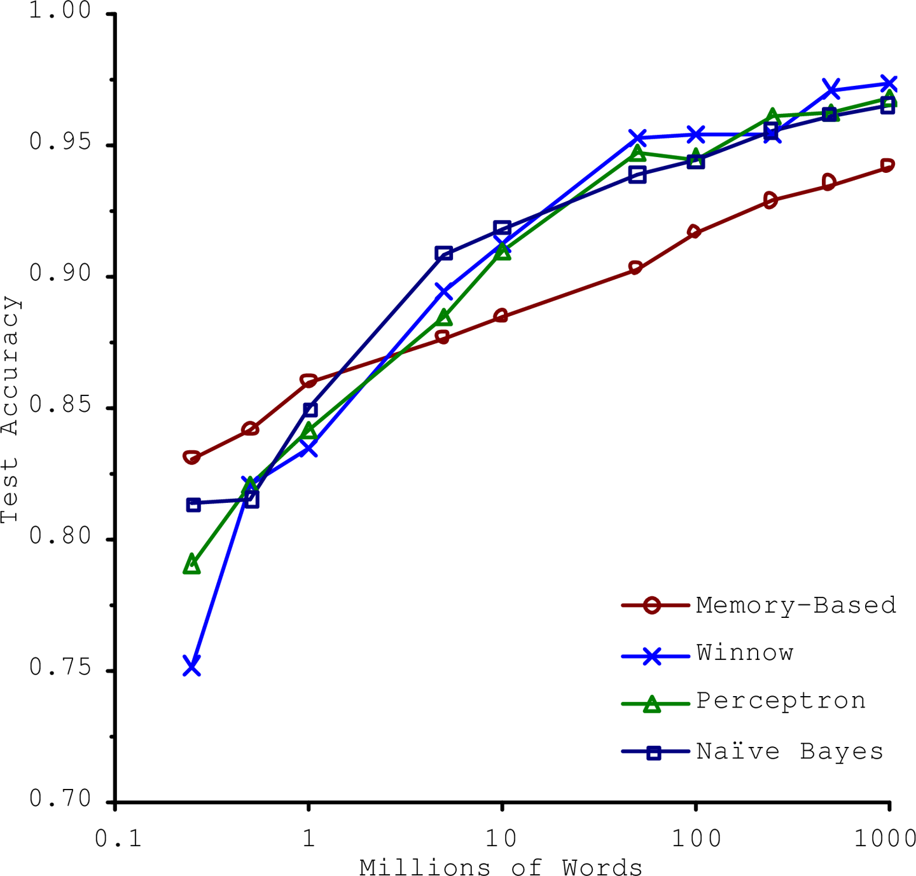
Main Challenges of Machine Learning
Challenge 1: “BAD DATA”
Insufficient Quantity of Training Data
Nonrepresentative Training Data
Poor-Quality Data
Irrelevant Features
[Banko and Brill, 2001]

Slide 28
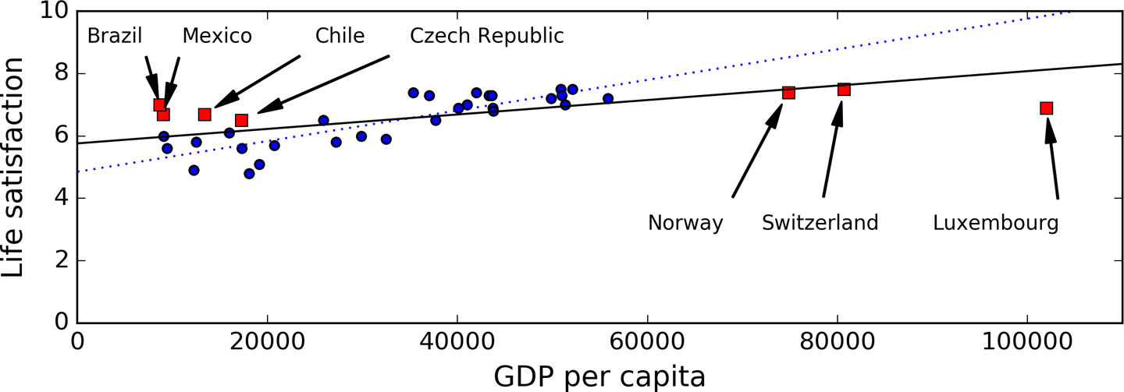
Main Challenges of Machine Learning
Challenge 1: “BAD DATA”
Insufficient Quantity of Training Data
Nonrepresentative Training Data
Poor-Quality Data
Irrelevant Features

Slide 29
Main Challenges of Machine Learning
Challenge 1: “BAD DATA”
Insufficient Quantity of Training Data
Nonrepresentative Training Data
Poor-Quality Data
clear outliers
handle missing values
Irrelevant Features

Slide 30
Main Challenges of Machine Learning
Challenge 1: “BAD DATA”
Insufficient Quantity of Training Data
Nonrepresentative Training Data
Poor-Quality Data
Irrelevant Features
select the most useful features
combine existing features to produce a more useful one
create new features by gathering new data
→ Feature engineering

Slide 31
Main Challenges of Machine Learning
Challenge 2: “BAD ALGORITHMS”
Training Data:
x₂
x₂
x₂
x₁
x₁
x₁
Under-fitting
Appropriate-fitting
Over-fitting

Slide 32
Main Challenges of Machine Learning
Challenge 2: “BAD ALGORITHMS”
Training Data:
Validation Data:
x₂
x₂
x₂
x₁
x₁
x₁
Under-fitting
Appropriate-fitting
Over-fitting

Slide 33
Main Challenges of Machine Learning
Challenge 2: “BAD ALGORITHMS”
The possible solutions for overfitting are:
To gather more training data
To reduce the noise in the training data (e.g., fix data errors and remove outliers)
To simplify the model
by selecting one with fewer parameters,
by reducing the number of attributes in the training data, or
by constraining the model (regularization)
…

Slide 34
Machine Learning Workflow
Test Data
Understand Data & Problem
Prepare Data
Train Model
Test Model
Launch Model
Train Test Loop

Slide 35
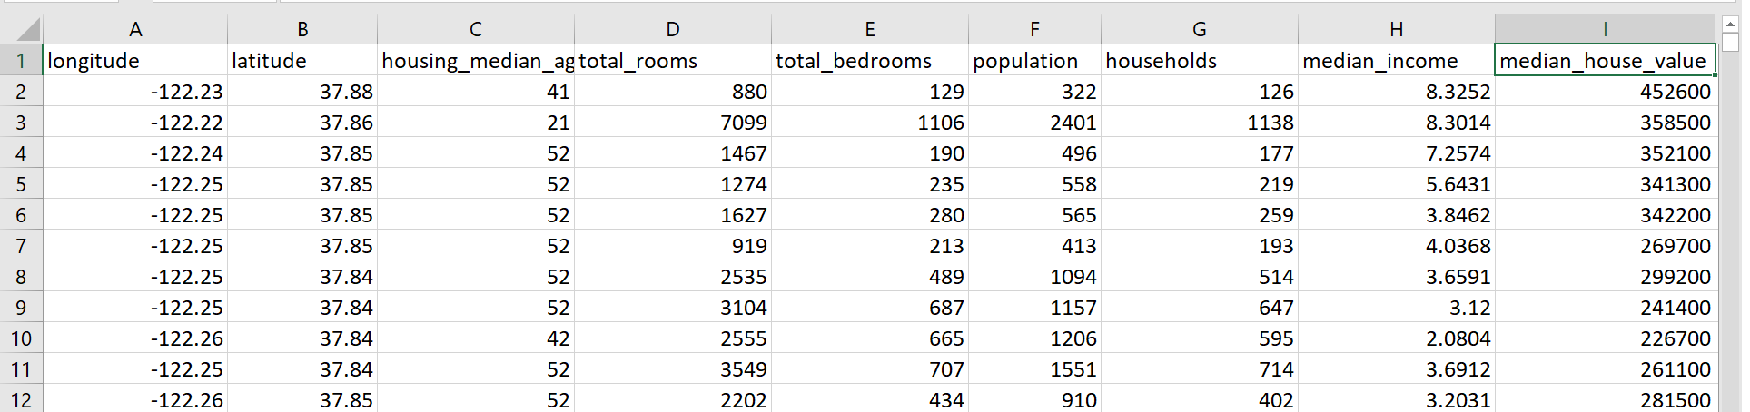
용어 정리
집값 예측 문제

Slide 36
용어 정리
Attribute
Feature = Attribute + its value (longitude = -122.23)
Labels
Instance(sample)

Slide 37
용어 정리
Attribute
Feature = Attribute + its value (longitude = -122.23)
Labels
Instance(sample)
Capital “X”
small letter “y”

Slide 38
용어 정리
Attribute
Feature = Attribute + its value (longitude = -122.23)
Labels
Instance(sample)
Capital “X”
small letter “y”
attributes = [‘longitude’, ‘latitude’, …, ‘median_income’]
number of attributes = number of features = dimension of data = 8
number of data (or instances or samples) = 11
size of data = number of data x number of attributes
In python code:
In [1]: print(X.shape)
Out[1]: (11, 8)

Slide 39
2. Data Preprocessing

Slide 40
Machine Learning Workflow
Test Data
Understand Data & Problem
Prepare Data
Train Model
Test Model
Launch Model
Train Test Loop

Slide 41
Machine Learning Workflow
Test Data
Understand Data & Problem
Prepare Data
Train Model
Test Model
Launch Model
Frame the Problem
Select a Performance Measure
Check the Assumptions
Train Test Loop

Slide 42
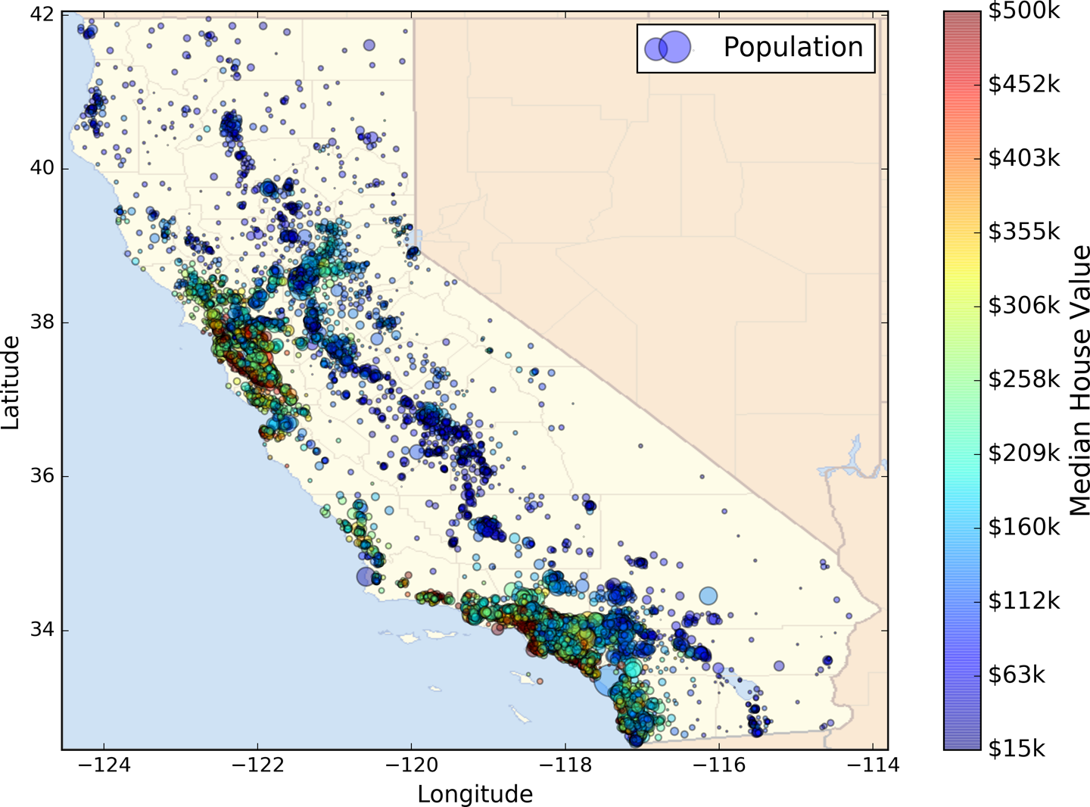
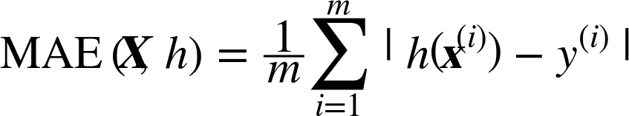
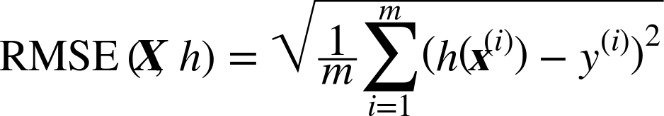
Look at the big picture
What is the problem?
To predict a district’s median housing price
What is the current solution looks like?
Estimation manually by experts
Costly and time-consuming
The error rate is about 15%
What is the objective?
Building a model better than the experts
What algorithms to select?
Labeled training example ➔ supervised learning
Predict a value of price, not categories of “cheap,” “medium,” or “expensive” ➔ regression
Small enough to fit in memory ➔ batch learning
What performance measure to use?
Root Mean Square Error or Mean Absolute Error?
How much effort to spend?
Performance measure

Slide 43
Machine Learning Workflow
Test Data
Understand Data & Problem
Prepare Data
Train Model
Test Model
Launch Model
Get the data and take a quick look
Create a test set
Discover and visualize the data to gain insights.
Visualizing Data
Looking for Correlations
Experimenting with Attribute Combinations
Prepare the data for Machine Learning algorithms.
Data Cleaning
Handling Text and Categorical Attributes
Custom Transformers
Feature Scaling
Transformation Pipelines
Train Test Loop

Slide 44
Data Preprocessing
A | B | C
 |  | low
 |  | high
 |  | low
 |  | high
 | NaN | low
 | NaN | high
 | NaN | low
 |  | high
 |  | low
 | NaN | high

Slide 45
Data Preprocessing
Create a Test Set
A | B | C
 |  | low
 |  | high
 |  | low
 |  | high
 | NaN | low
 | NaN | high
 | NaN | low
 |  | high
A | B | C
 |  | low
 |  | high
 |  | low
 |  | high
 | NaN | low
 | NaN | high
 | NaN | low
 |  | high
 |  | low
 | NaN | high
A | B | C
 |  | low
 | NaN | high

Slide 46
Data Preprocessing
Create a Test Set
Add Attributes
A | B | C
 |  | low
 |  | high
 |  | low
 |  | high
 | NaN | low
 | NaN | high
 | NaN | low
 |  | high
A | B | C | A/B
 |  | low
 |  | high
 |  | low
 |  | high
 | NaN | low | NaN
 | NaN | high | NaN
 | NaN | low | NaN
 |  | high
A | B | C
 |  | low
 |  | high
 |  | low
 |  | high
 | NaN | low
 | NaN | high
 | NaN | low
 |  | high
 |  | low
 | NaN | high
A | B | C
 |  | low
 | NaN | high

Slide 47
Data Preprocessing
Create a Test Set
Add Attributes
Data Cleaning
A | B | C
 |  | low
 |  | high
 |  | low
 |  | high
 | NaN | low
 | NaN | high
 | NaN | low
 |  | high
A | B | C | A/B
 |  | low
 |  | high
 |  | low
 |  | high
 | NaN | low | NaN
 | NaN | high | NaN
 | NaN | low | NaN
 |  | high
A | B | C | A/B
 |  | low
 |  | high
 |  | low
 |  | high
 | $$\overline{B}$$ | low | $$\overline{A/B}$$
 | $$\overline{B}$$ | high | $$\overline{A/B}$$
 | $$\overline{B}$$ | low | $$\overline{A/B}$$
 |  | high
A | B | C
 |  | low
 |  | high
 |  | low
 |  | high
 | NaN | low
 | NaN | high
 | NaN | low
 |  | high
 |  | low
 | NaN | high
A | B | C
 |  | low
 | NaN | high

Slide 48
Data Preprocessing
Create a Test Set
Add Attributes
Data Cleaning
One Hot Encoding
A | B | C
 |  | low
 |  | high
 |  | low
 |  | high
 | NaN | low
 | NaN | high
 | NaN | low
 |  | high
A | B | C | A/B
 |  | low
 |  | high
 |  | low
 |  | high
 | NaN | low | NaN
 | NaN | high | NaN
 | NaN | low | NaN
 |  | high
A | B | C | A/B
 |  | low
 |  | high
 |  | low
 |  | high
 | $$\overline{B}$$ | low | $$\overline{A/B}$$
 | $$\overline{B}$$ | high | $$\overline{A/B}$$
 | $$\overline{B}$$ | low | $$\overline{A/B}$$
 |  | high
A | B | C | A/B
 |  | [1, 0]
 |  | [0, 1]
 |  | [1, 0]
 |  | [0, 1]
 | $$\overline{B}$$ | [1, 0] | $$\overline{A/B}$$
 | $$\overline{B}$$ | [0, 1] | $$\overline{A/B}$$
 | $$\overline{B}$$ | [1, 0] | $$\overline{A/B}$$
 |  | [0, 1]
A | B | C
 |  | low
 |  | high
 |  | low
 |  | high
 | NaN | low
 | NaN | high
 | NaN | low
 |  | high
 |  | low
 | NaN | high
A | B | C
 |  | low
 | NaN | high

Slide 49
Data Preprocessing
Create a Test Set
Add Attributes
Data Cleaning
One Hot Encoding
Scaling
A | B | C
 |  | low
 |  | high
 |  | low
 |  | high
 | NaN | low
 | NaN | high
 | NaN | low
 |  | high
A | B | C | A/B
 |  | low
 |  | high
 |  | low
 |  | high
 | NaN | low | NaN
 | NaN | high | NaN
 | NaN | low | NaN
 |  | high
A | B | C | A/B
 |  | low
 |  | high
 |  | low
 |  | high
 | $$\overline{B}$$ | low | $$\overline{A/B}$$
 | $$\overline{B}$$ | high | $$\overline{A/B}$$
 | $$\overline{B}$$ | low | $$\overline{A/B}$$
 |  | high
A | B | C | A/B
 |  | [1, 0]
 |  | [0, 1]
 |  | [1, 0]
 |  | [0, 1]
 | $$\overline{B}$$ | [1, 0] | $$\overline{A/B}$$
 | $$\overline{B}$$ | [0, 1] | $$\overline{A/B}$$
 | $$\overline{B}$$ | [1, 0] | $$\overline{A/B}$$
 |  | [0, 1]
A | B | C | A/B
 |  | [1, 0]
 |  | [0, 1]
 |  | [1, 0]
 |  | [0, 1]
 | $$0$$ | [1, 0] | $$0$$
 | $$0$$ | [0, 1] | $$0$$
 | $$0$$ | [1, 0] | $$0$$
 |  | [0, 1]
A | B | C
 |  | low
 |  | high
 |  | low
 |  | high
 | NaN | low
 | NaN | high
 | NaN | low
 |  | high
 |  | low
 | NaN | high
A | B | C
 |  | low
 | NaN | high

Slide 50
Data Preprocessing
Create a Test Set
Add Attributes
Data Cleaning
One Hot Encoding
Scaling
A | B | C
 |  | low
 |  | high
 |  | low
 |  | high
 | NaN | low
 | NaN | high
 | NaN | low
 |  | high
A | B | C | A/B
 |  | low
 |  | high
 |  | low
 |  | high
 | NaN | low | NaN
 | NaN | high | NaN
 | NaN | low | NaN
 |  | high
A | B | C | A/B
 |  | low
 |  | high
 |  | low
 |  | high
 | $$\overline{B}$$ | low | $$\overline{A/B}$$
 | $$\overline{B}$$ | high | $$\overline{A/B}$$
 | $$\overline{B}$$ | low | $$\overline{A/B}$$
 |  | high
A | B | C | A/B
 |  | [1, 0]
 |  | [0, 1]
 |  | [1, 0]
 |  | [0, 1]
 | $$\overline{B}$$ | [1, 0] | $$\overline{A/B}$$
 | $$\overline{B}$$ | [0, 1] | $$\overline{A/B}$$
 | $$\overline{B}$$ | [1, 0] | $$\overline{A/B}$$
 |  | [0, 1]
A | B | C | A/B
 |  | [1, 0]
 |  | [0, 1]
 |  | [1, 0]
 |  | [0, 1]
 | $$0$$ | [1, 0] | $$0$$
 | $$0$$ | [0, 1] | $$0$$
 | $$0$$ | [1, 0] | $$0$$
 |  | [0, 1]
A | B | C
 |  | low
 |  | high
 |  | low
 |  | high
 | NaN | low
 | NaN | high
 | NaN | low
 |  | high
 |  | low
 | NaN | high
use same mean, std
A | B | C
 |  | low
 | NaN | high
A | B | C | A/B
 |  | low
 | NaN | high | NaN
A | B | C | A/B
 |  | low
 | $$\overline{B}$$ | high | $$\overline{A/B}$$
A | B | C | A/B
 |  | [1, 0]
 | $$\overline{B}$$ | [0, 1] | $$\overline{A/B}$$
A | B | C | A/B
 |  | [1, 0]
 | $$0$$ | [0, 1] | $$0$$

Slide 51
Create a Test Set - Stratified Split
Training Set
Training Data
Strata
Test Set

Slide 52
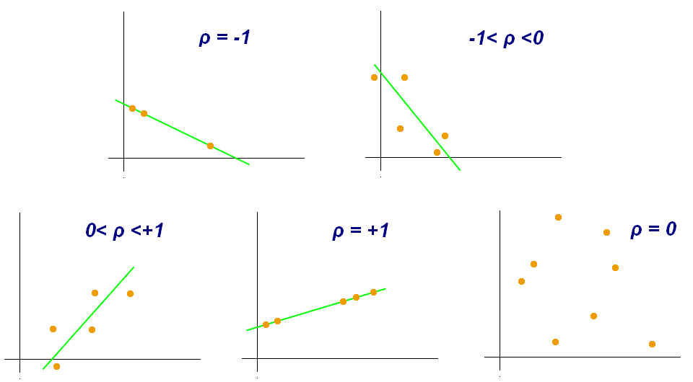
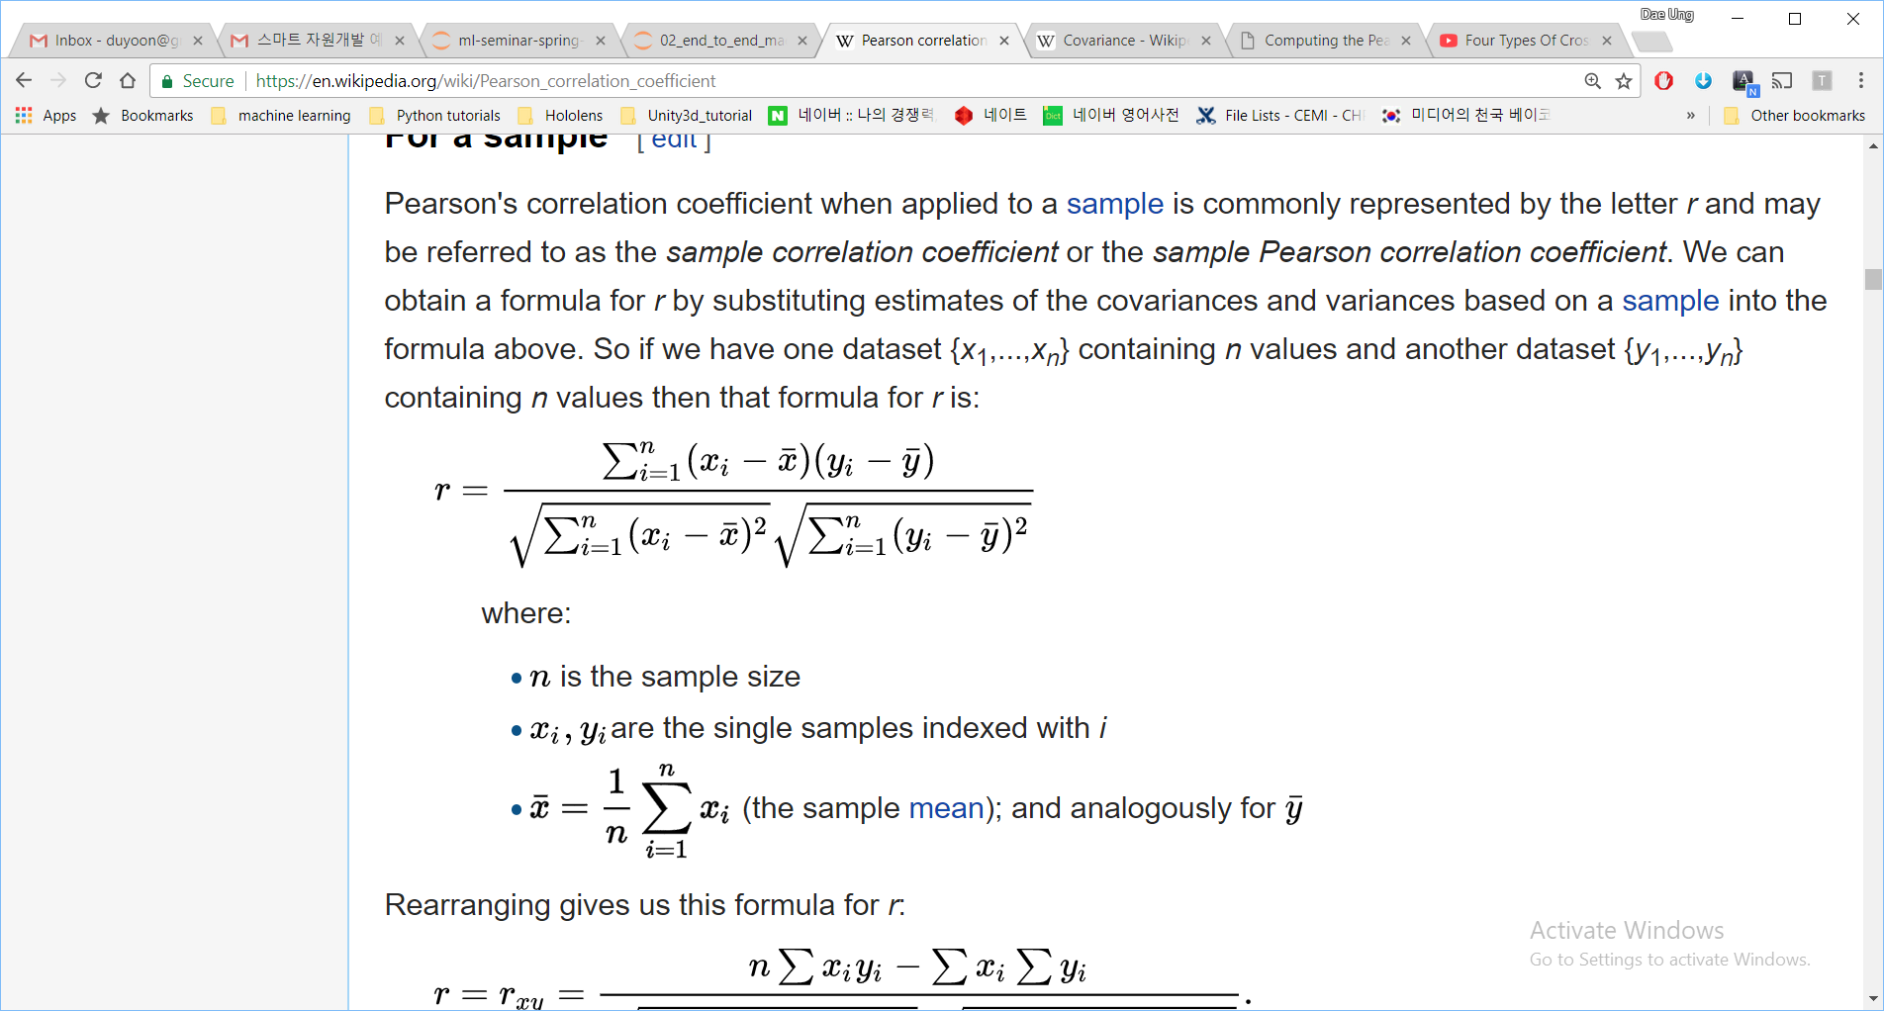
Looking for Correlations
Standard correlation coefficient (Pearson’s r):
A measure of the linear correlation between two variables X and Y.
It has a value between +1 and −1, where 1 is total positive linear correlation, 0 is no linear correlation, and −1 is total negative linear correlation.

Slide 53
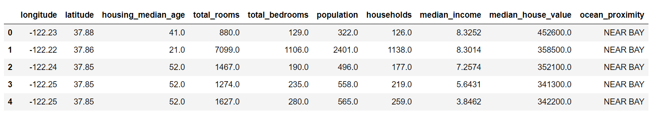
Experimenting with Attribute Combinations
Gain insights after exploring data
Try out various attribute combinations
room_per_household = total_rooms / households
bedrooms_per_room = total_bedrooms / total_rooms
population_per_household = polulation / households
➔ Check correlations

Slide 54
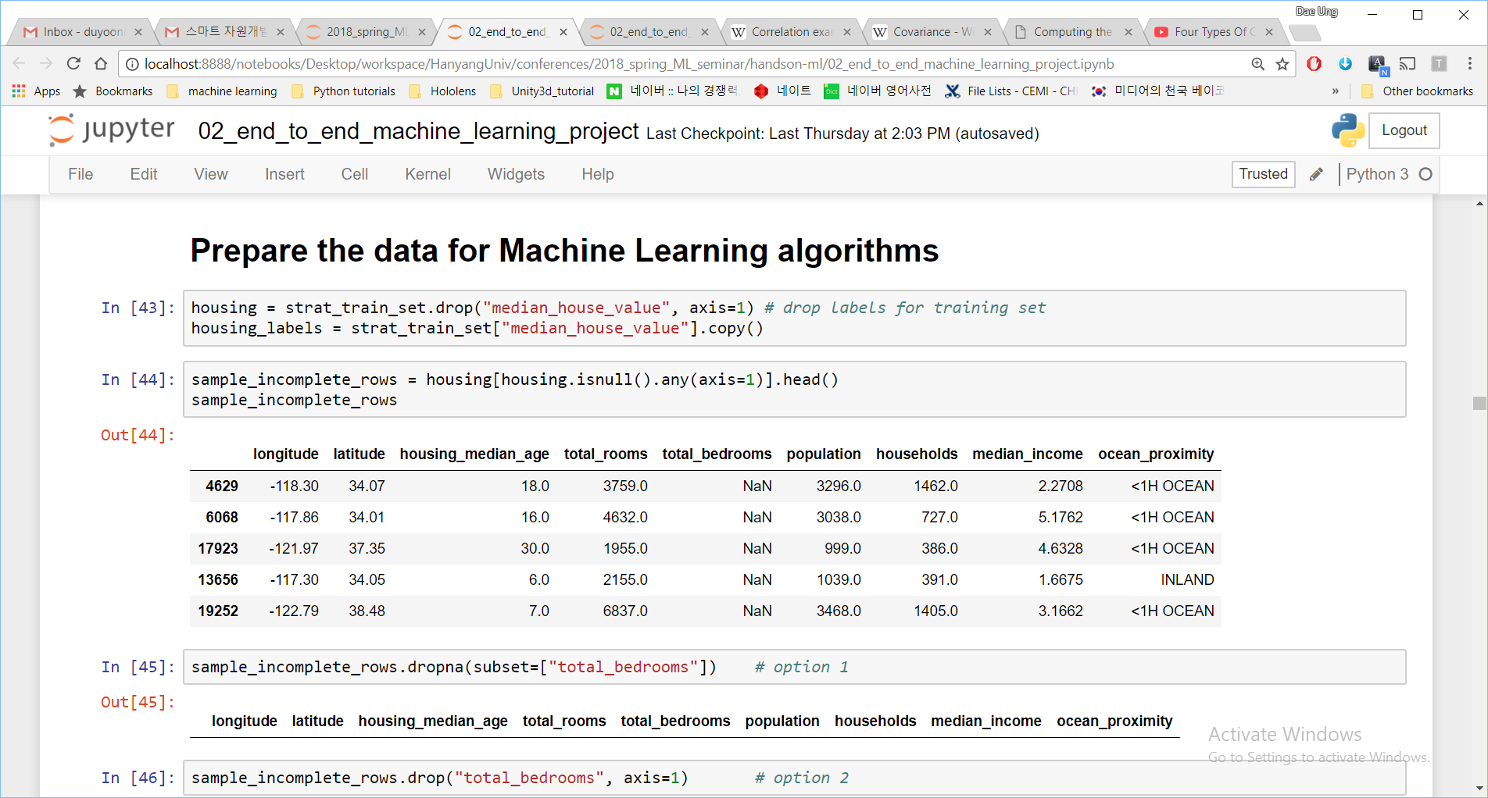
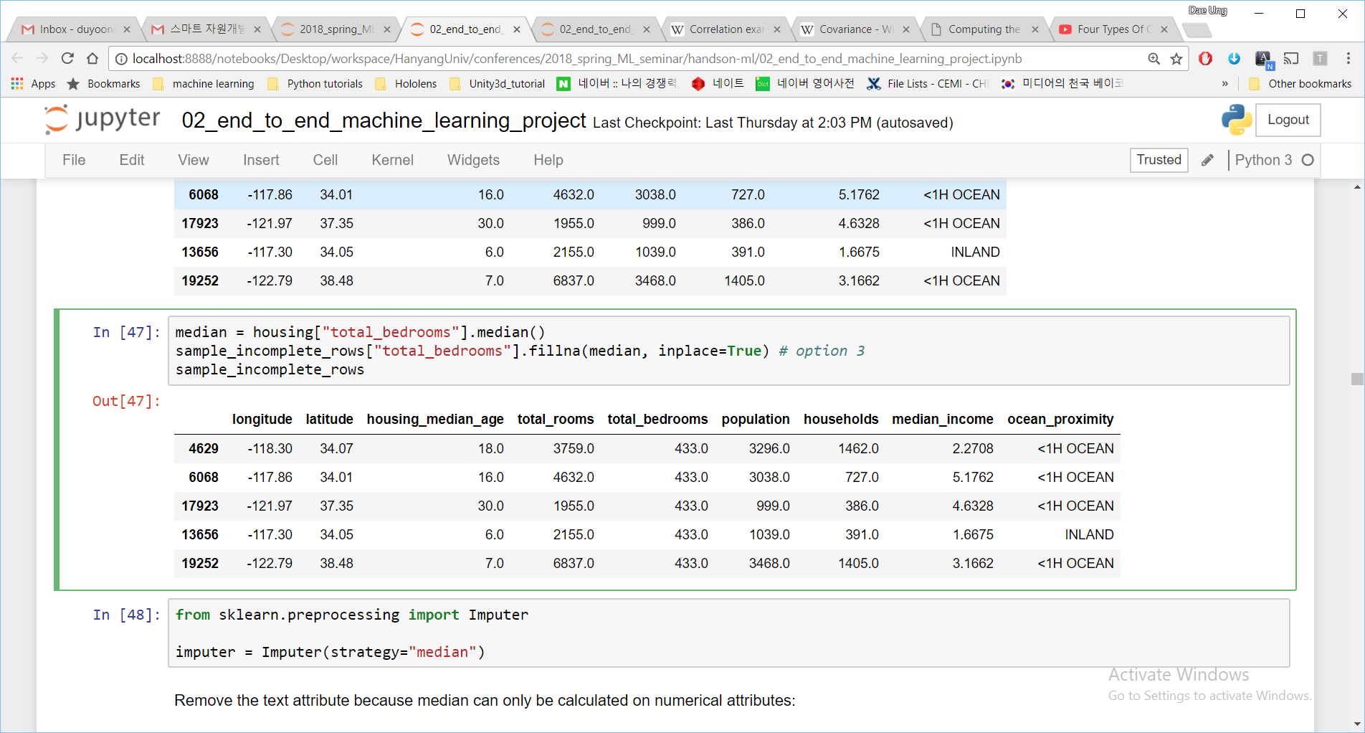
Data Cleaning
Example: set NaN to median
Handling missing values:
Get rid of the samples
Get rid of the whole attribute
Set the missing values to some values (zero, mean, median, etc)

Slide 55
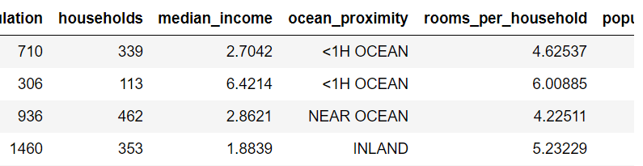
Handling Text and Categorical Attributes
Convert text labels to numbers:
Label Encoding:
One Hot Encoding:
Low
Medium
High
0
1
2
One Hot Encoding
1 | 0 | 0 | 0 | 0
1 | 0 | 0 | 0 | 0
0 | 0 | 0 | 0 | 1
0 | 1 | 0 | 0 | 0
Cat
Dog
Horse
1 | 0 | 0
0 | 1 | 0
0 | 0 | 1

Slide 56
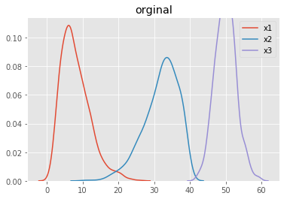
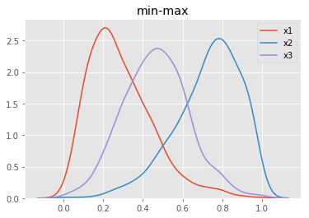
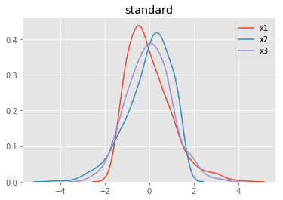
Feature Scaling
Min-max Scaling:
$$x^{′}=\frac{x−min⁡(x)}{\max\left(x\right)−min⁡(x)}$$
Standard Scaling:
$$x^{′}=\frac{x−\overline{x}}{σ}$$
$\overline{x} : mean, σ :standard deviation$

Slide 57
Transformation Pipelines
Create a Test Set
Add Attributes
Data Cleaning
One Hot Encoding
Scaling
A | B | C
 |  | low
 |  | high
 |  | low
 |  | high
 | NaN | low
 | NaN | high
 | NaN | low
 |  | high
A | B | C | A/B
 |  | low
 |  | high
 |  | low
 |  | high
 | NaN | low | NaN
 | NaN | high | NaN
 | NaN | low | NaN
 |  | high
A | B | C | A/B
 |  | low
 |  | high
 |  | low
 |  | high
 | $$\overline{B}$$ | low | $$\overline{A/B}$$
 | $$\overline{B}$$ | high | $$\overline{A/B}$$
 | $$\overline{B}$$ | low | $$\overline{A/B}$$
 |  | high
A | B | C | A/B
 |  | [1, 0]
 |  | [0, 1]
 |  | [1, 0]
 |  | [0, 1]
 | $$\overline{B}$$ | [1, 0] | $$\overline{A/B}$$
 | $$\overline{B}$$ | [0, 1] | $$\overline{A/B}$$
 | $$\overline{B}$$ | [1, 0] | $$\overline{A/B}$$
 |  | [0, 1]
A | B | C | A/B
 |  | [1, 0]
 |  | [0, 1]
 |  | [1, 0]
 |  | [0, 1]
 | $$0$$ | [1, 0] | $$0$$
 | $$0$$ | [0, 1] | $$0$$
 | $$0$$ | [1, 0] | $$0$$
 |  | [0, 1]
A | B | C
 |  | low
 |  | high
 |  | low
 |  | high
 | NaN | low
 | NaN | high
 | NaN | low
 |  | high
 |  | low
 | NaN | high
use same mean, std
A | B | C
 |  | low
 | NaN | high
A | B | C | A/B
 |  | low
 | NaN | high | NaN
A | B | C | A/B
 |  | low
 | $$\overline{B}$$ | high | $$\overline{A/B}$$
A | B | C | A/B
 |  | [1, 0]
 | $$\overline{B}$$ | [0, 1] | $$\overline{A/B}$$
A | B | C | A/B
 |  | [1, 0]
 | $$0$$ | [0, 1] | $$0$$

Slide 58
Transformation Pipelines
Create a Test Set
A | B | C
 |  | low
 |  | high
 |  | low
 |  | high
 | NaN | low
 | NaN | high
 | NaN | low
 |  | high
A | B | C | A/B
 |  | [1, 0]
 |  | [0, 1]
 |  | [1, 0]
 |  | [0, 1]
 | $$0$$ | [1, 0] | $$0$$
 | $$0$$ | [0, 1] | $$0$$
 | $$0$$ | [1, 0] | $$0$$
 |  | [0, 1]
A | B | C
 |  | low
 |  | high
 |  | low
 |  | high
 | NaN | low
 | NaN | high
 | NaN | low
 |  | high
 |  | low
 | NaN | high
Add Attributes
Data Cleaning
One Hot Encoding
Scaling
A | B | C
 |  | low
 | NaN | high
A | B | C | A/B
 |  | [1, 0]
 | $$0$$ | [0, 1] | $$0$$
Add Attributes
Data Cleaning
One Hot Encoding
Scaling

Slide 59
Next…
Test Data
Understand Data & Problem
Prepare Data
Train Model
Test Model
Launch Model
Train Test Loop

Slide 60
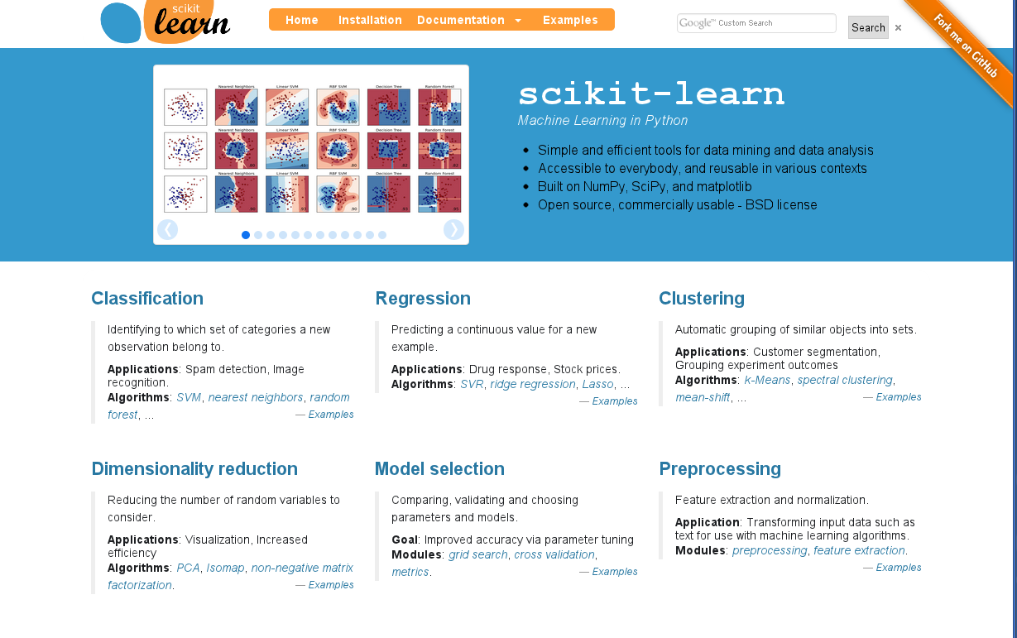
scikit-learn
One of the most popular Python libraries for doing Machine Learning
Provides simple and efficient tools for data modeling and analysis, built on top of Numpy, SciPy, and matplotlib
http://scikit-learn.org

Slide 61
scikit-learn 4-step preprocessing pattern
Step 1: Import the preprocessing class you plan to use
from sklearn.preprocessing import StandardScaler
Step 2: Instantiate the preprocessor
scaler = StandardScaler()
Step 3: Fit the preprocessor with data
scaler.fit(data)
Step 4: Transform data
data_scaled = scaler.transform(data)

Slide 62
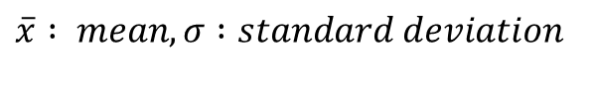
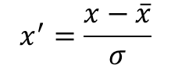
scikit-learn 4-step preprocessing pattern
Step 1: Import the preprocessing class you plan to use
from sklearn.preprocessing import StandardScaler
Step 2: Instantiate the preprocessor
scaler = StandardScaler()
Standard Scaling:
Step 3: Fit the preprocessor with data
$$x^{′}=\frac{x−\overline{x}}{σ}$$
scaler.fit(data)
$\overline{x} : mean, σ :standard deviation$
Step 4: Transform data
data_scaled = scaler.transform(data)

Slide 63
scikit-learn 4-step preprocessing pattern
Step 1: Import the preprocessing class you plan to use
from sklearn.preprocessing import StandardScaler
Step 2: Instantiate the preprocessor
scaler = StandardScaler()
Standard Scaling:
Step 3: Fit the preprocessor with data
$$x^{′}=\frac{x−\overline{x}}{σ}$$
scaler.fit(data)
$\overline{x} : mean, σ :standard deviation$
Step 4: Transform data
data_scaled = scaler.transform(data)

Slide 64
scikit-learn 4-step preprocessing pattern
Step 1: Import the preprocessing class you plan to use
from sklearn.preprocessing import StandardScaler
Step 2: Instantiate the preprocessor
scaler = StandardScaler()
Step 3: Fit the preprocessor with data
scaler.fit(data)
Step 3: Fit and transform
Step 4: Transform data
data_scaled = scaler.fit_transform(data)
data_scaled = scaler.transform(data)

Slide 65
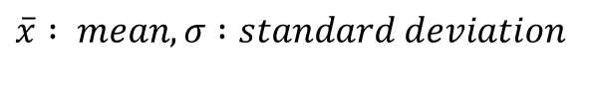
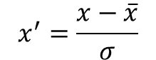
scikit-learn 4-step preprocessing pattern
Step 1: Import the preprocessing class you plan to use
from sklearn.preprocessing import StandardScaler
Step 2: Instantiate the preprocessor
scaler = StandardScaler()
Standard Scaling:
Step 3: Fit and transform
$$x^{′}=\frac{x−\overline{x}}{σ}$$
train_data_scaled = scaler.fit_transform(train_data)
Step 4: Transform test data
$\overline{x} : mean, σ :standard deviation$
test_data_scaled = scaler.transform(test_data)

Slide 66
scikit-learn 4-step modeling pattern
Step 1: Import the class you plan to use
from sklearn.linear_model import LinearRegression
Step 2: Instantiate the model
model = LinearRegression()
Step 3: Fit the model with training data
model.fit(train_data)
Step 4: Predict the response for a new (test) data
pred = model.predict(test_data)

